Slide 1
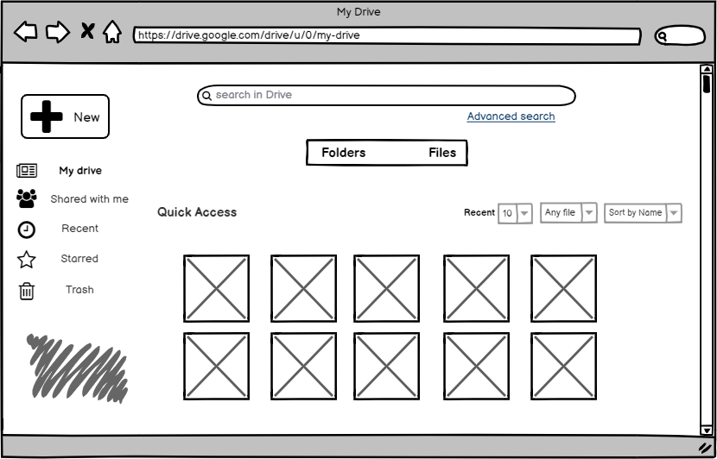
Redesign 1 - Change the way of file presentation at Quick Access
Change setting here

Slide 2
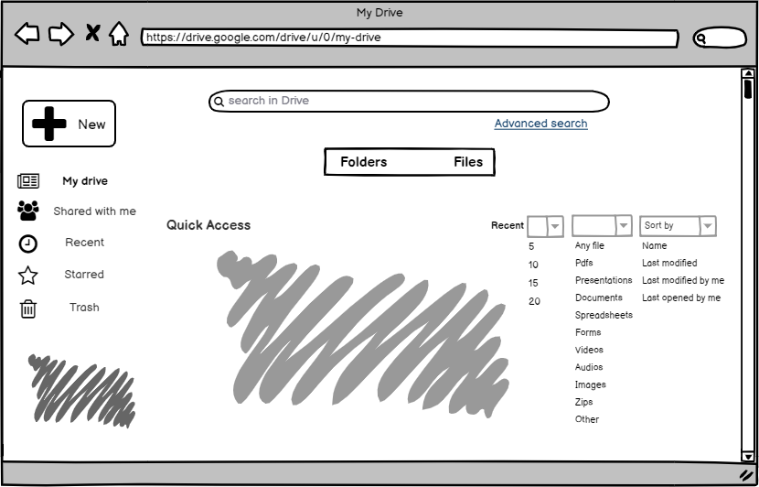
Redesign 1 - Change the way of file presentation at Quick Access
Choose recent file #, file type, and sorting method

Slide 3
Redesign 2 - Activate advanced search option
Click here

Slide 4
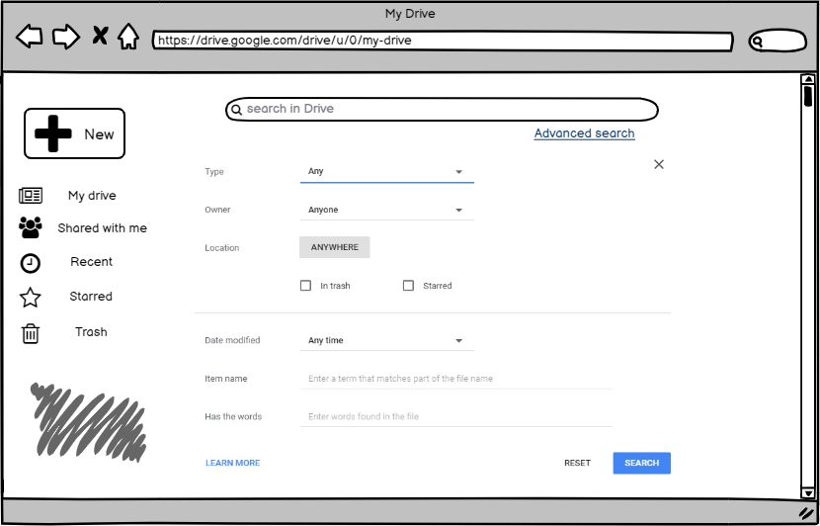
Redesign 2 - Activate advanced search option

Slide 5
Redesign 3 - Filter files on My Drive
Click here

Slide 6
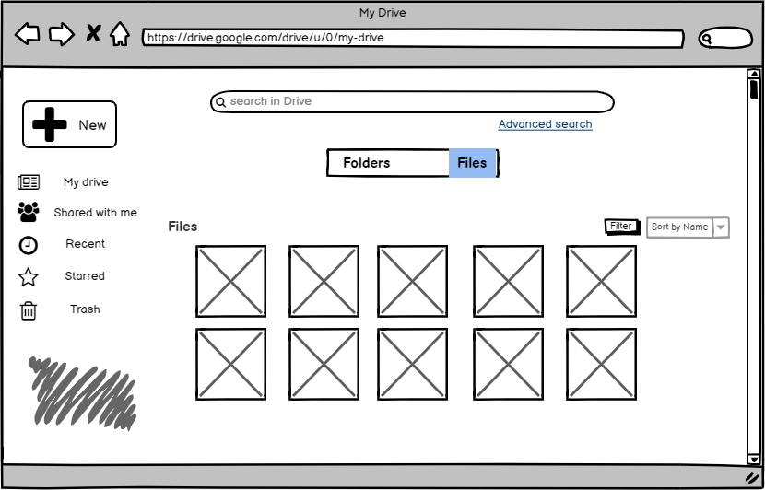
Redesign 3 - Filter files on My Drive
Display changed from Quick Access to Files

Slide 7
Redesign 3 - Filter files on My Drive
Click here

Slide 8
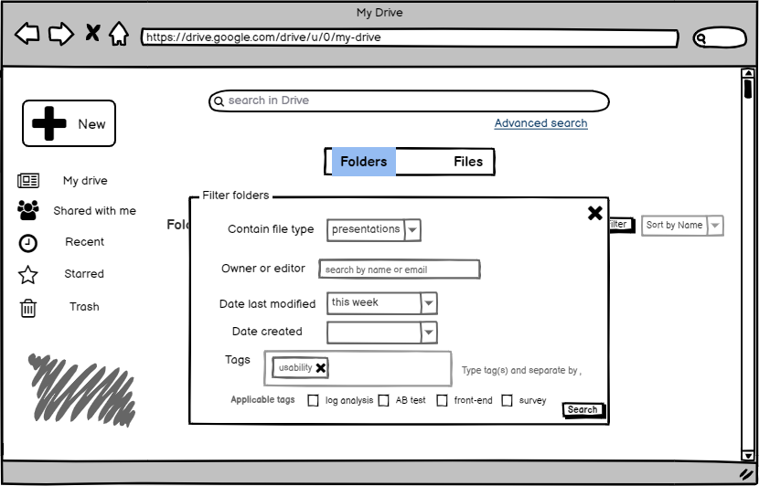
Redesign 3 - Filter files on My Drive
Filter files by various ways
*Assume tags are generated at folder/file creation/uploading stage and used as ‘applicable tags’ here

Slide 9
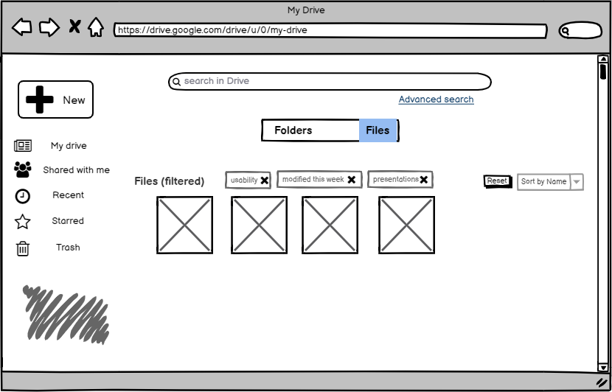
Redesign 3 - Filter files on My Drive
Filtered files. Filters can be removed/reset

Slide 10
Redesign 4 - Filter folders on My Drive
Click here

Slide 11
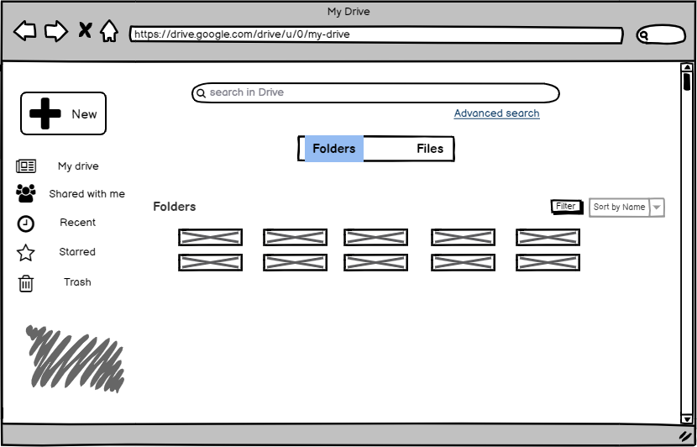
Redesign 4 - Filter folders on My Drive
Display changed from Quick Access to Folders

Slide 12
Redesign 4 - Filter folders on My Drive
Click here

Slide 13
Redesign 4 - Filter folders on My Drive
Filter folders by various ways
*Assume tags are generated at file/folder creation/uploading stage and used as ‘applicable tags’ here

Slide 14
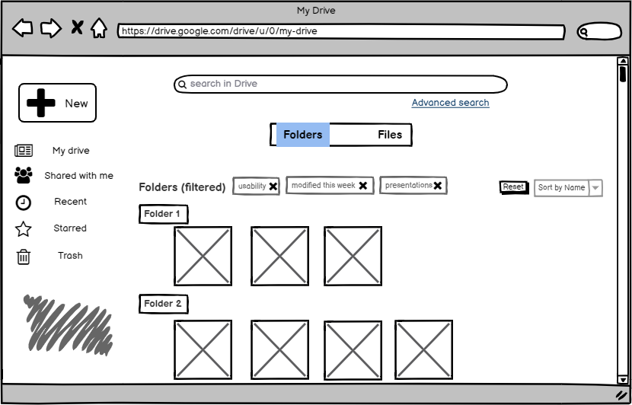
Redesign 4 - Filter folders on My Drive
Filtered folders and corresponding files. Filters can be removed/reset

